Slide 1
DSC640 Weekly Assignment
Week 3 & 4
Edris Safari

Slide 2
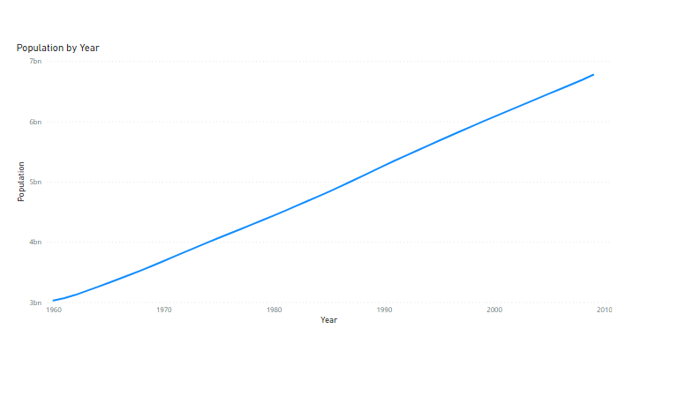
PowerBI Line Chart

Slide 3
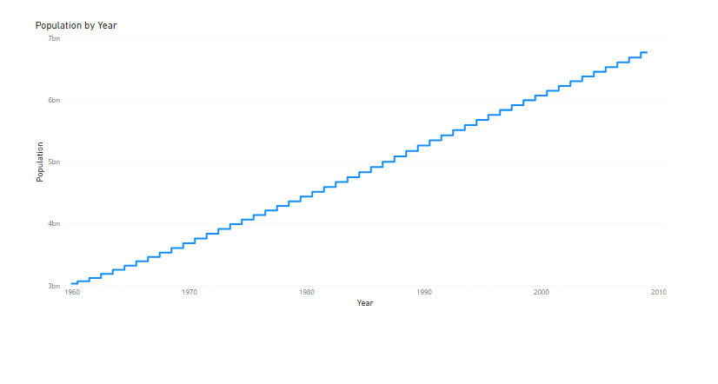
PowerBI Step Chart

Slide 4
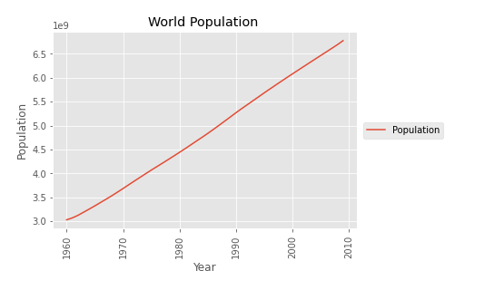
Python Line Chart

Slide 5
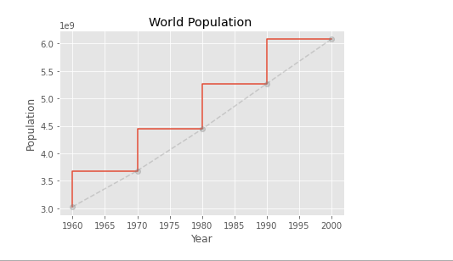
Python Step Chart

Slide 6
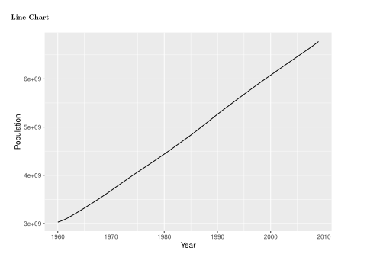
R Line Chart

Slide 7
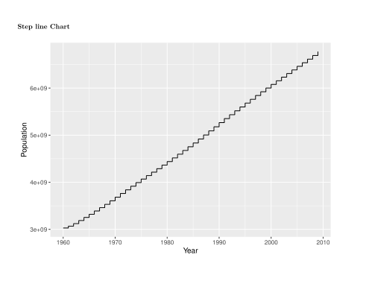
R Step Chart

